Slide 1
Street Easy
Custom Boundaries
How people define their search, spatially

Slide 2
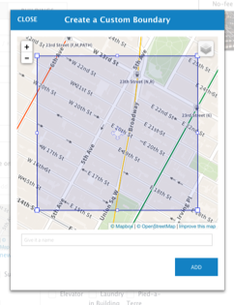
Custom boundaries
More than 300k custom maps
Of those, more than 35% were created in 2016
76272 unique users
Yet, only 7419 of them are professional agents

Slide 3
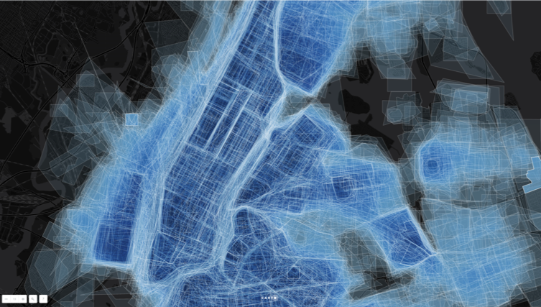

Slide 4
New Jersey

Slide 5
Forest Hill

Slide 6
Flushing

Slide 7
Jihee’s

Slide 8
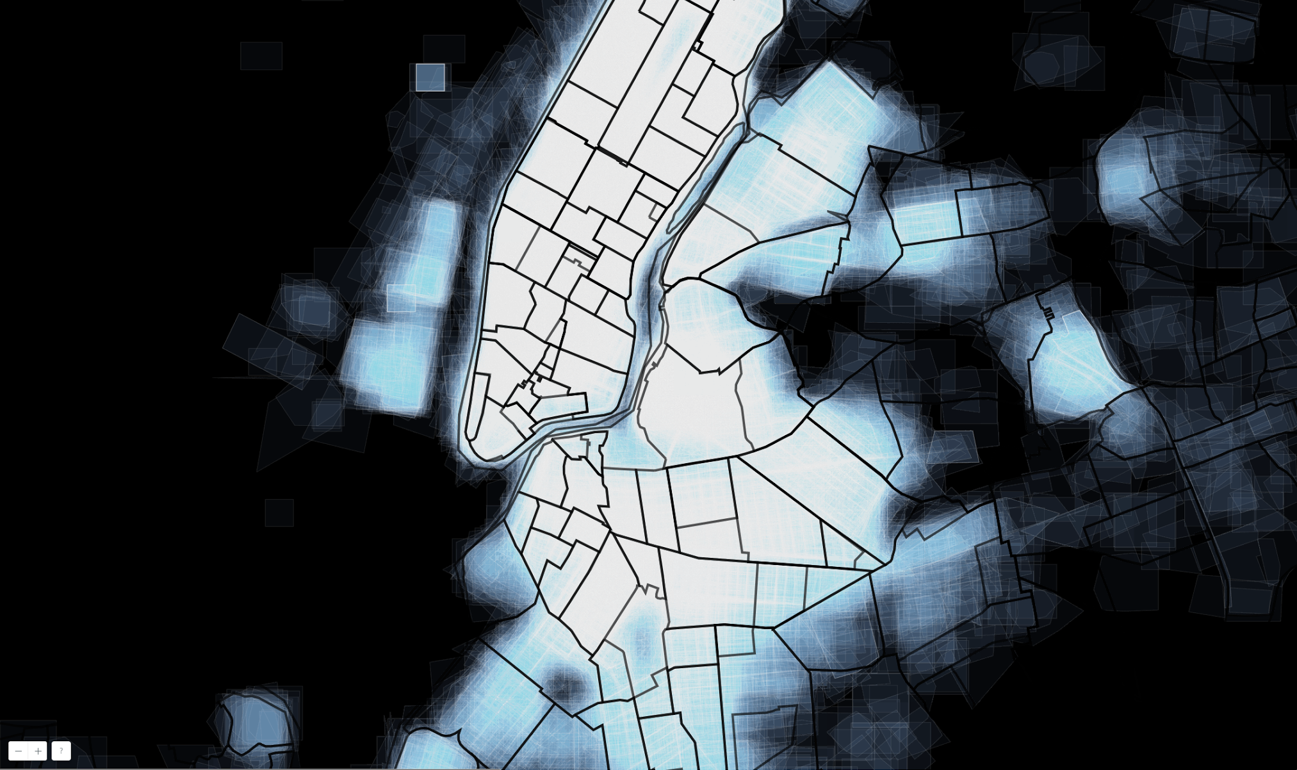
Border Split
Road Grid

Slide 9

Boundary Names

Slide 10
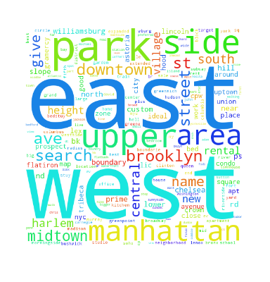
Names: word clouds

Slide 11
Custom vs “Official”

Slide 12
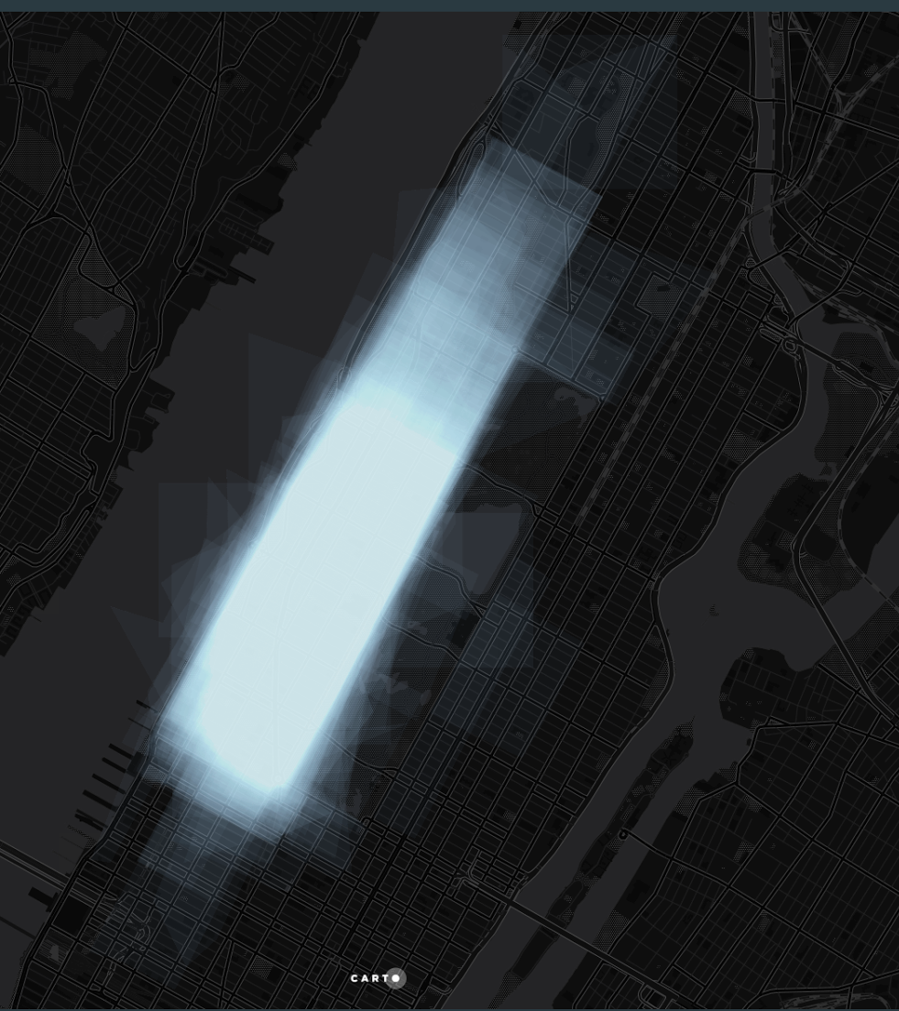
Upper West Side

Slide 13
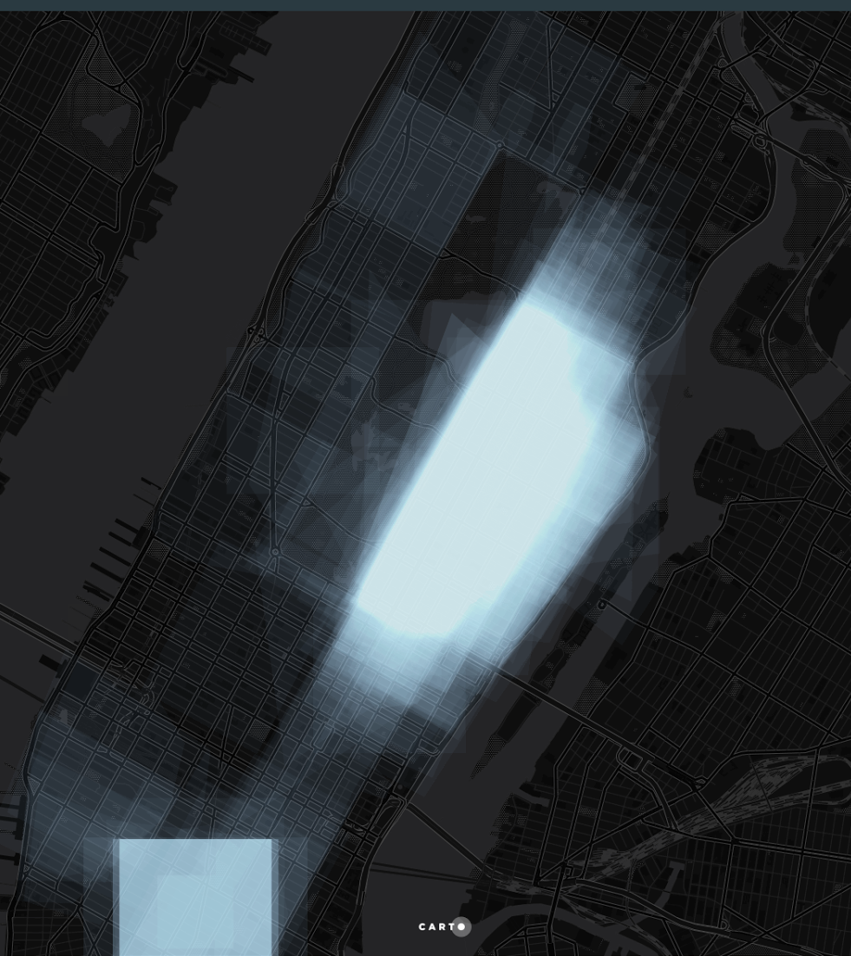
Upper East Side

Slide 14
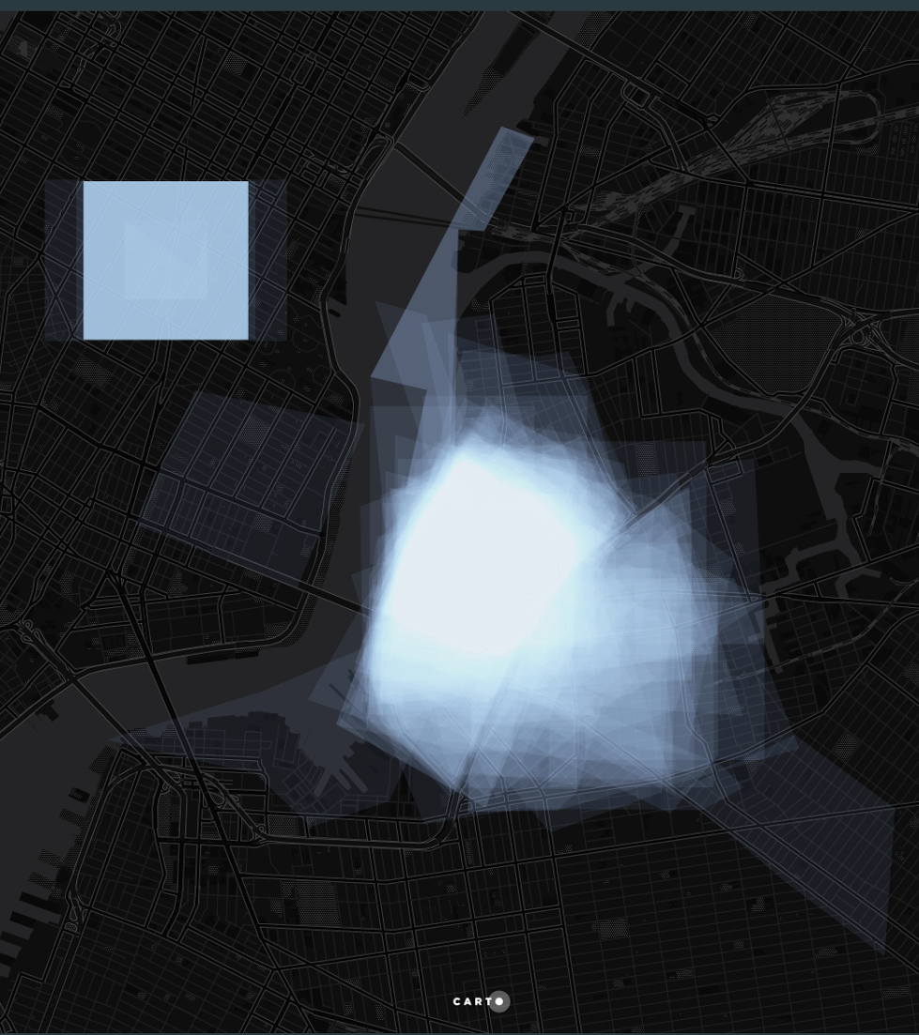
Williamsburg

Slide 15
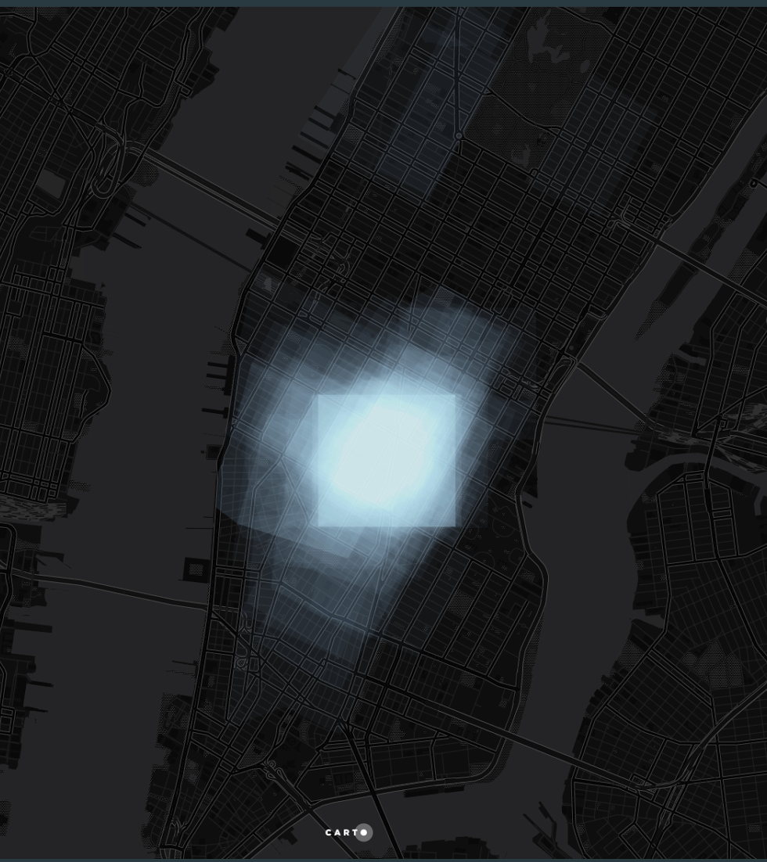
Flatiron

Slide 16
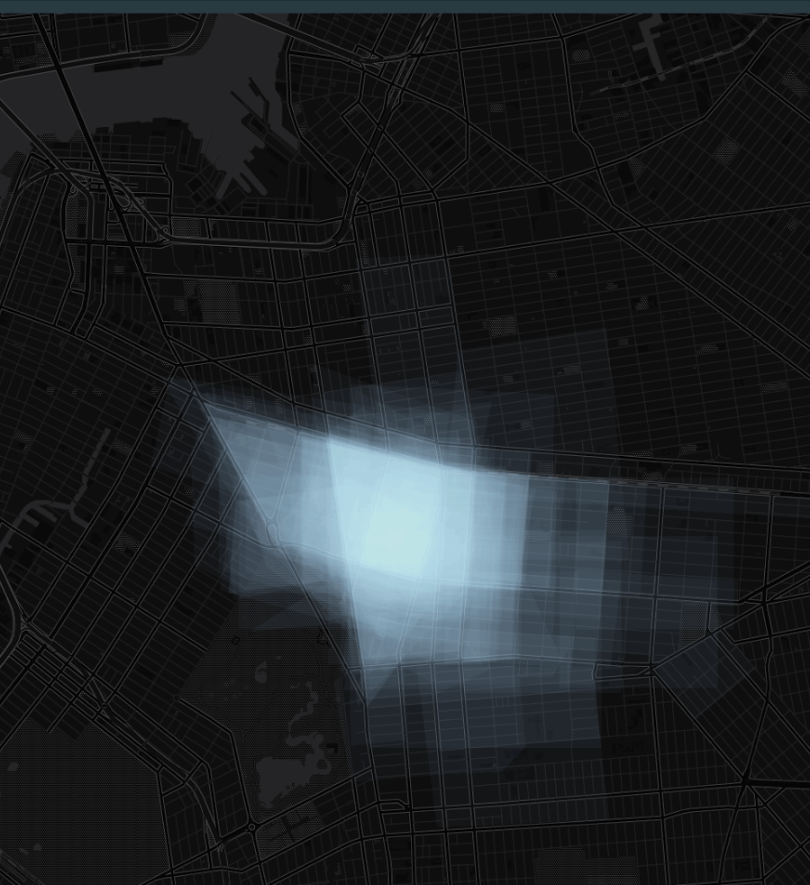
Crown Heights

Slide 17
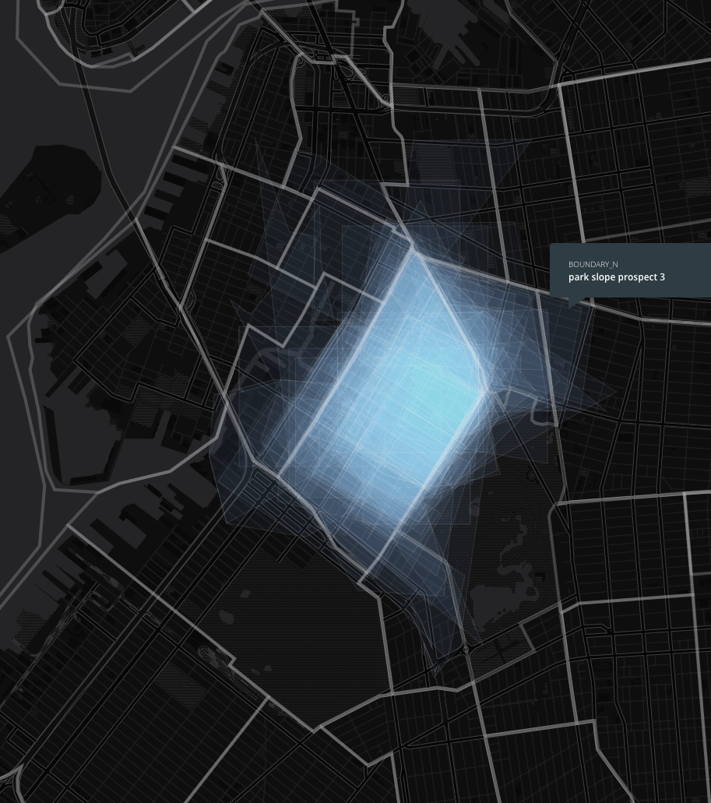
Park Slope

Slide 18
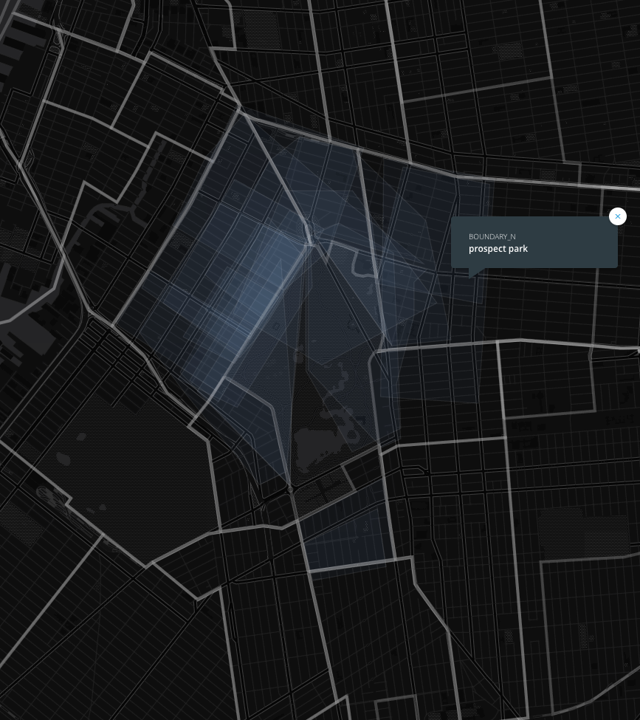
Prospect park

Slide 19
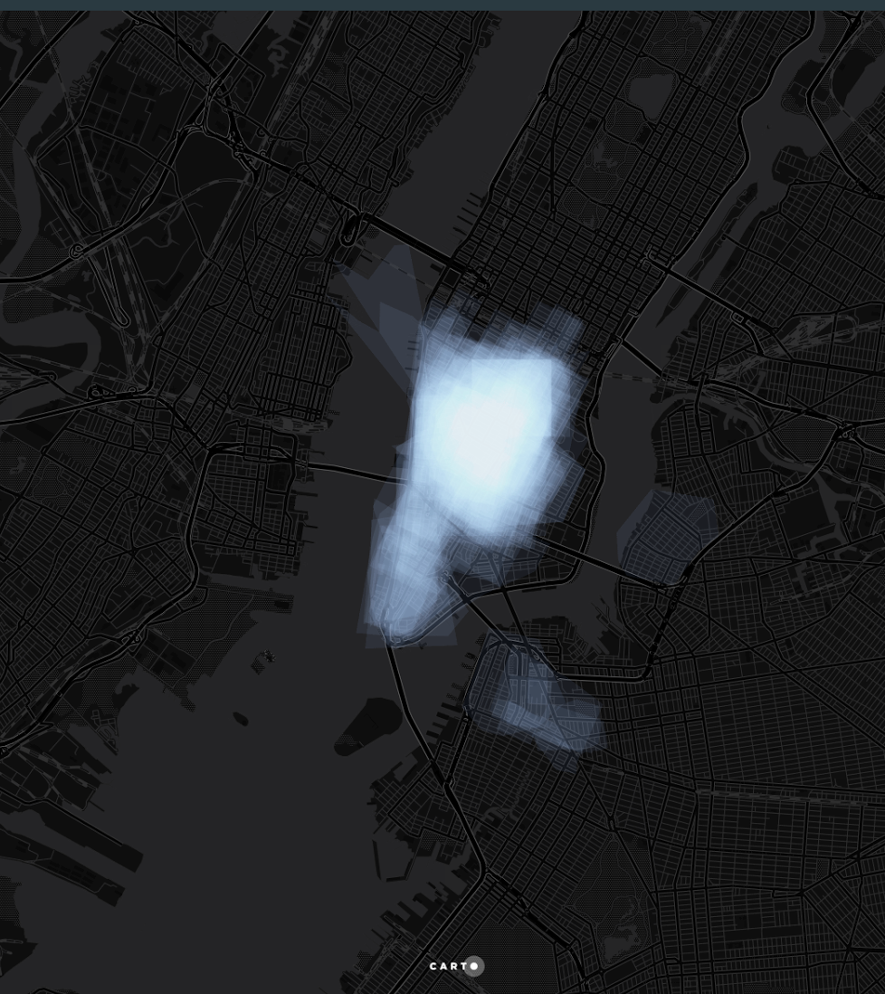
“DOWNTOWN”

Slide 20
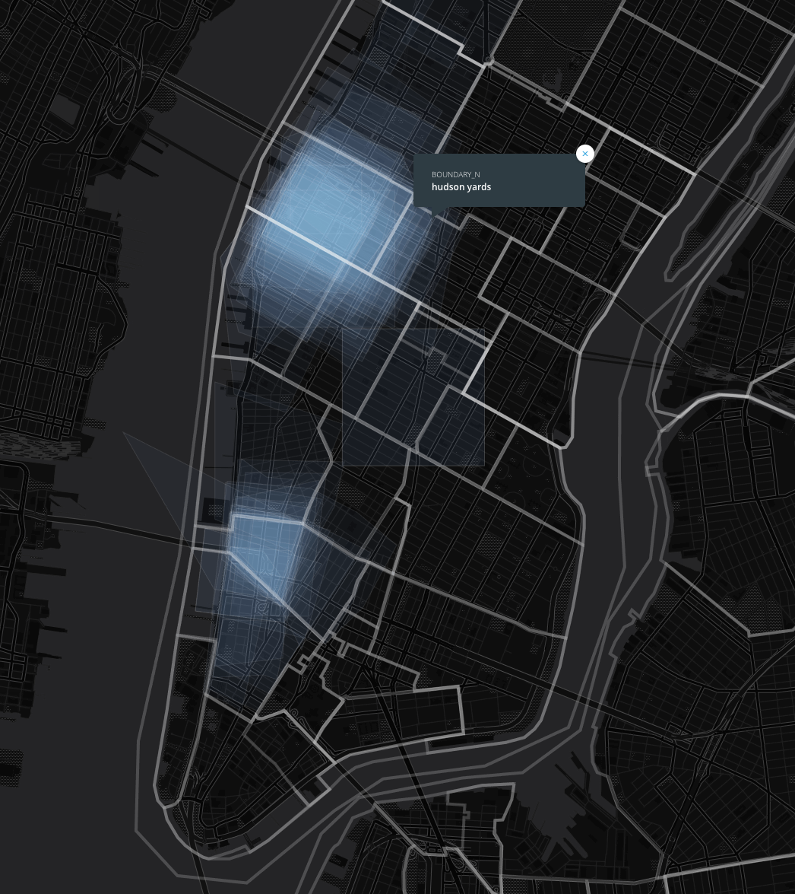
Hudson Yards (%%hudson%%)

Slide 21
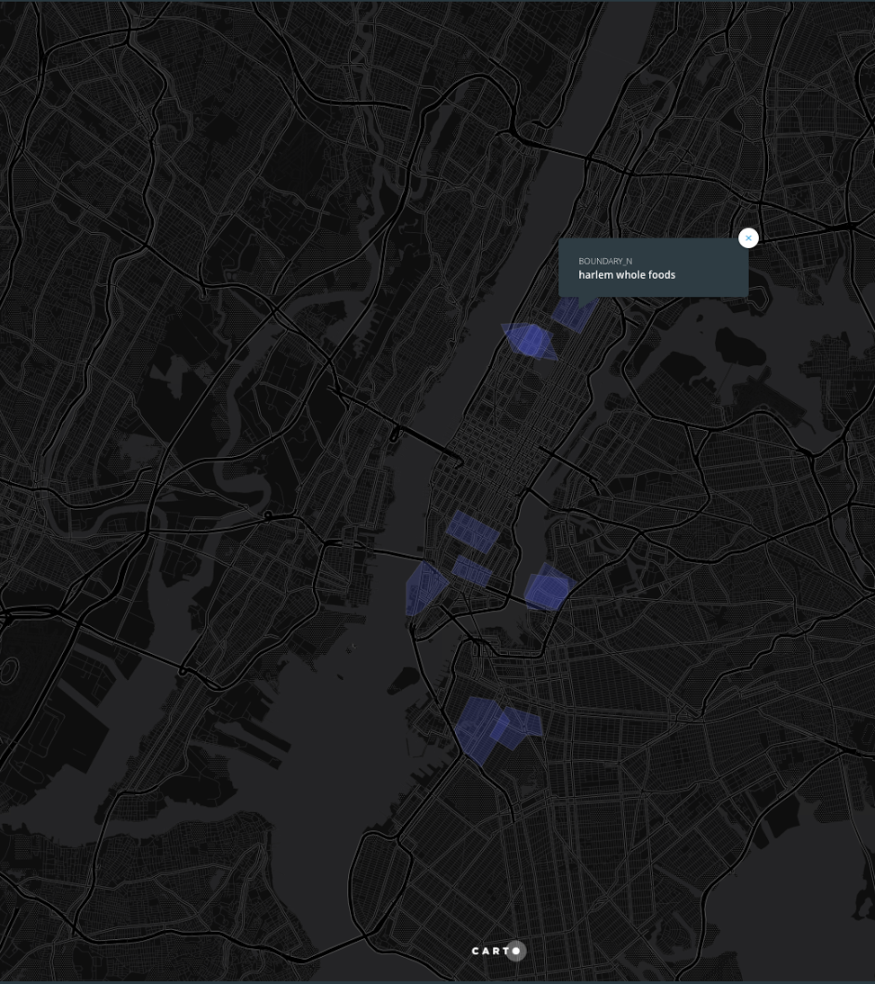
Whole foods

Slide 22
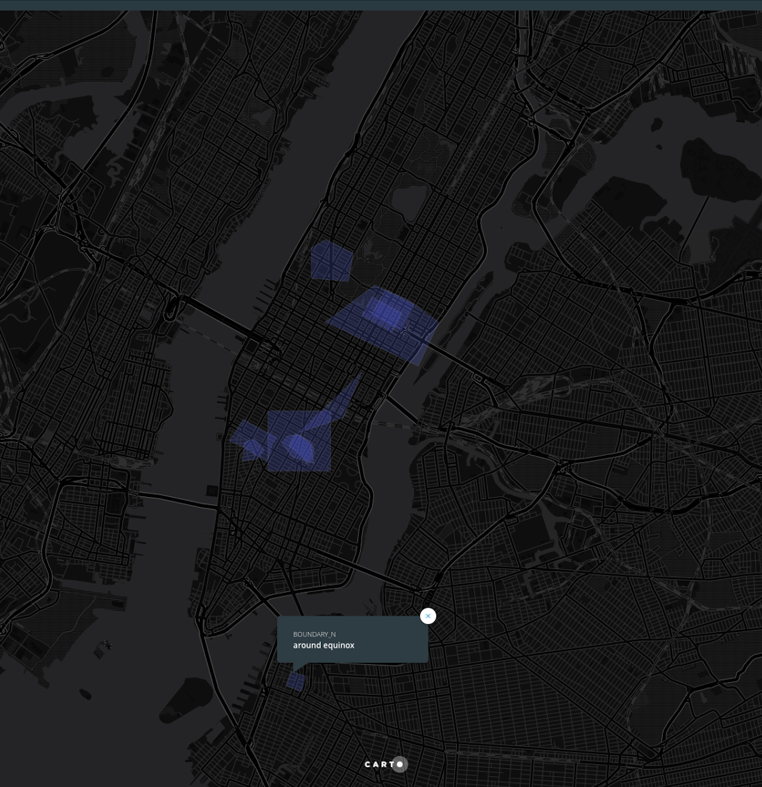
Equinox

Slide 23
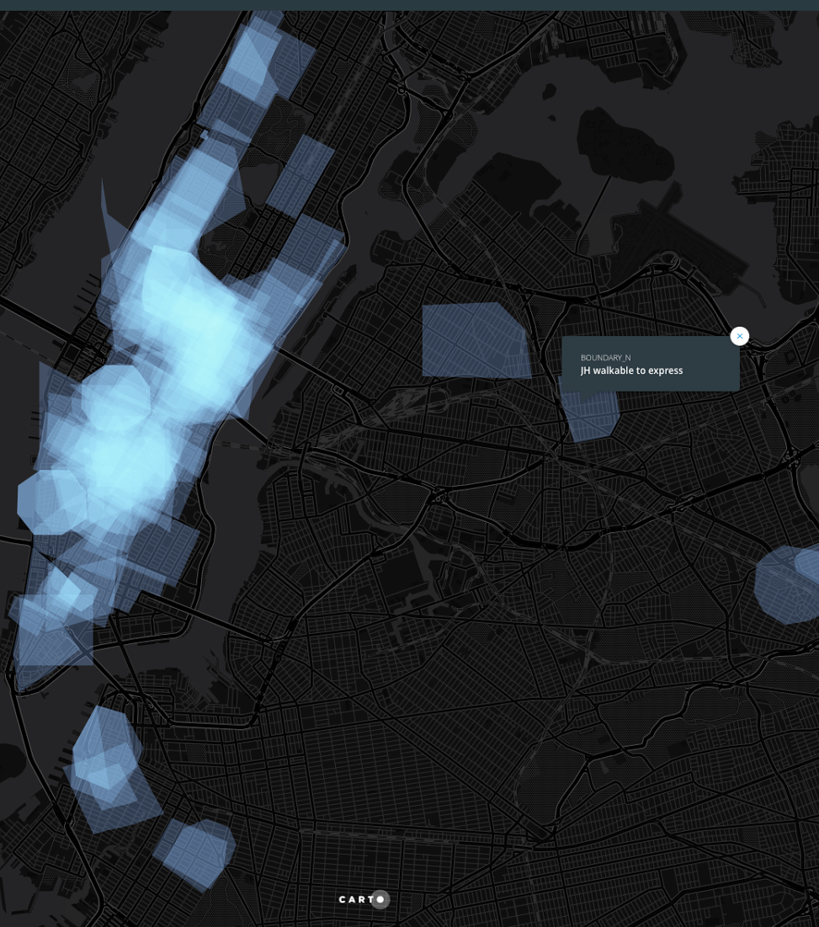
“Walkable”

Slide 24
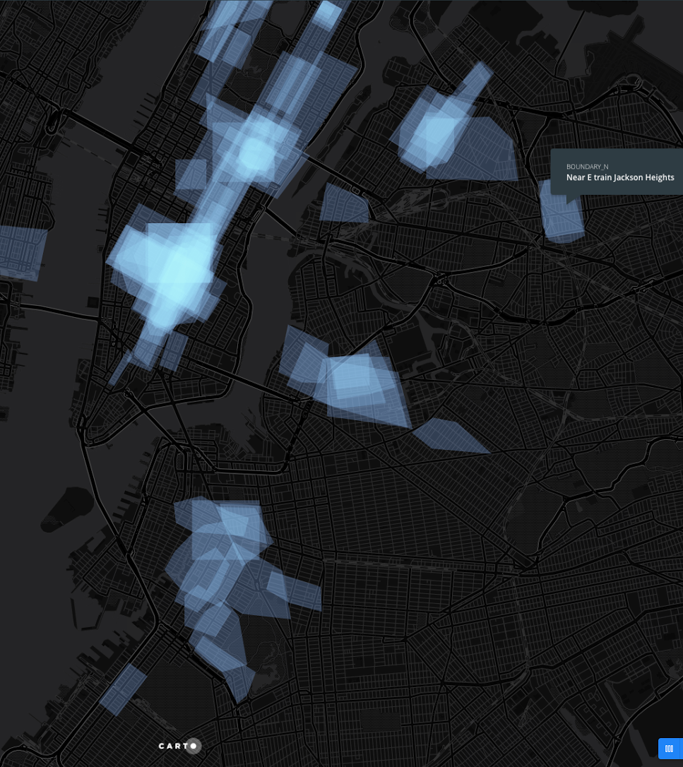
“Train”

Slide 25
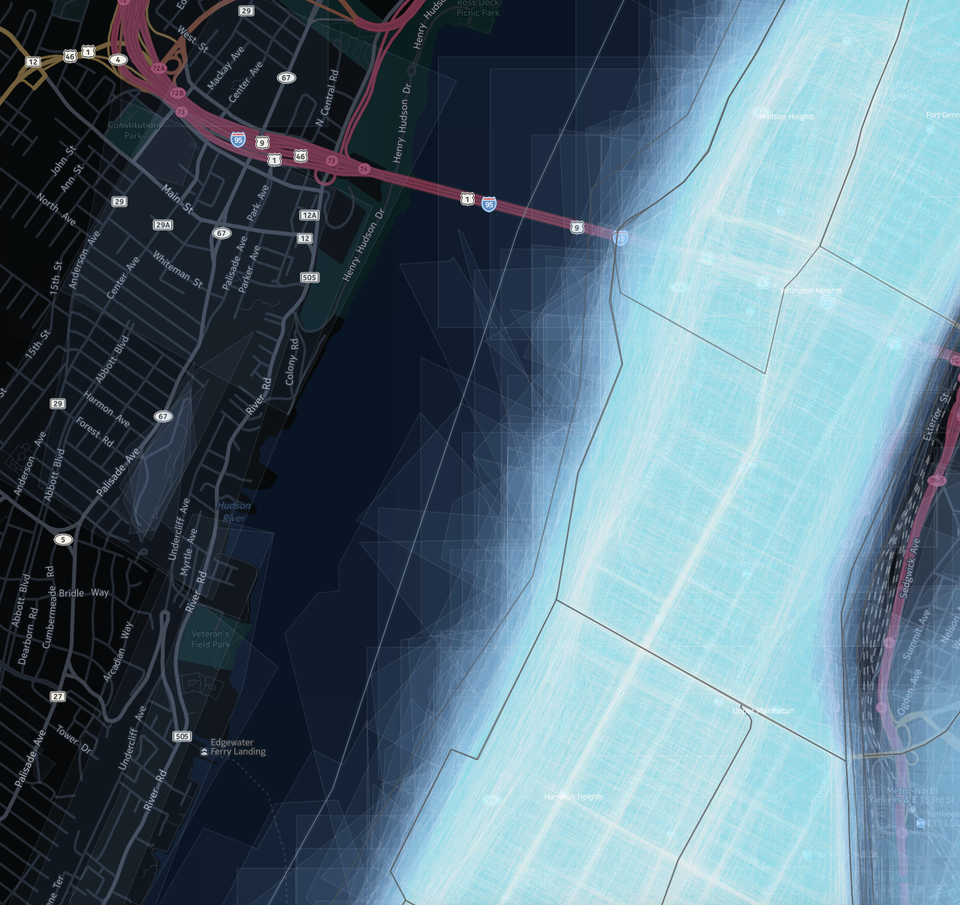
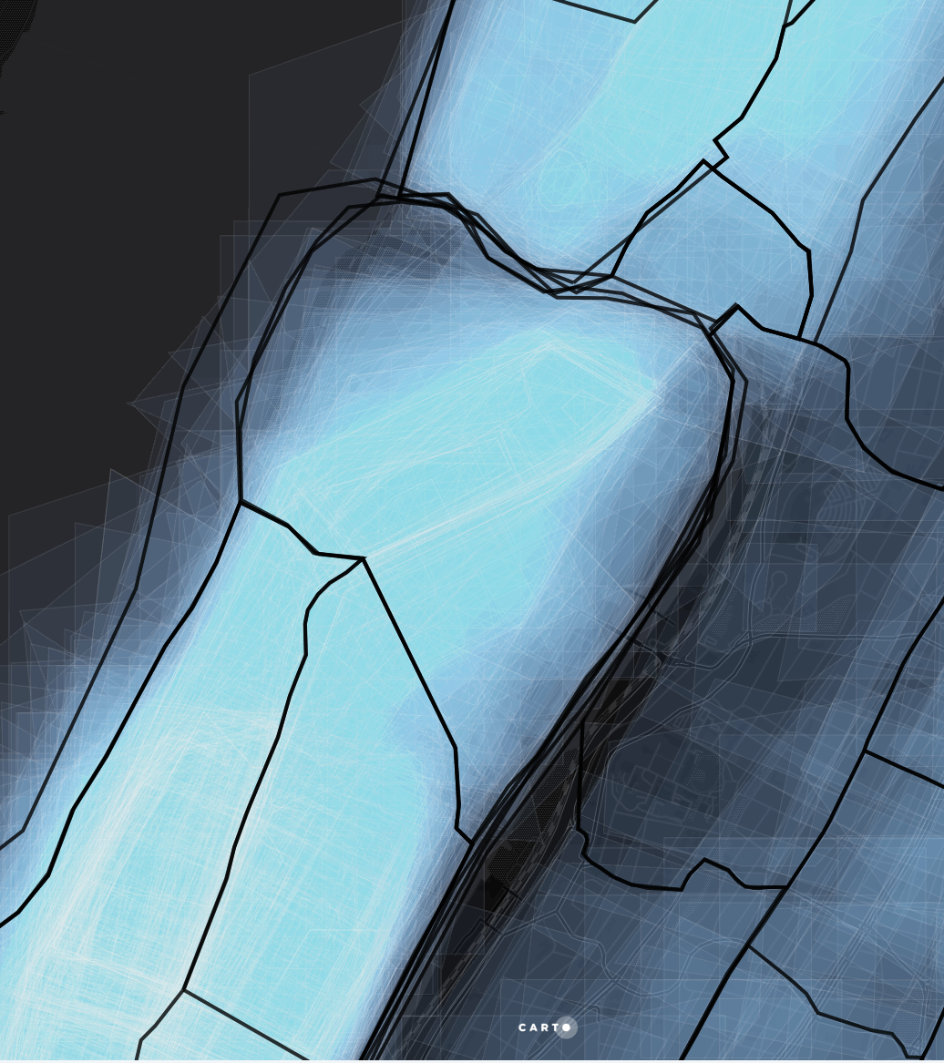
Horisontal House
Horisontal
House

Slide 26
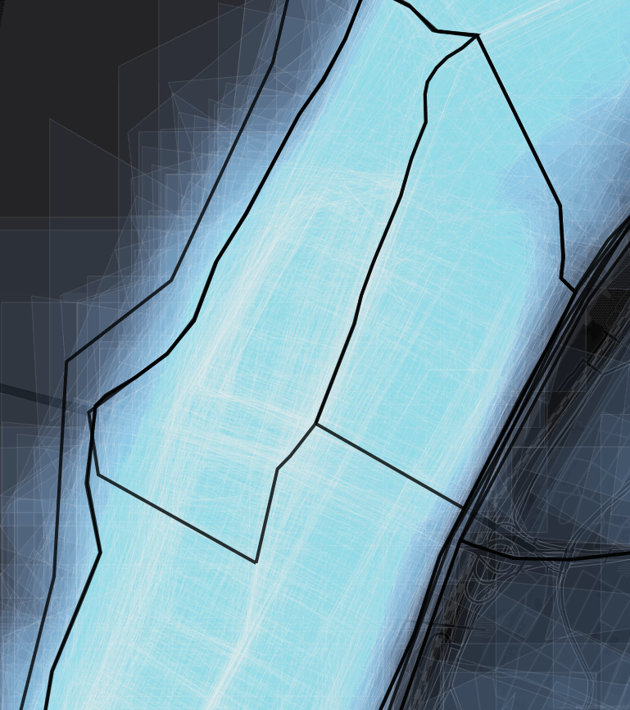
Upper Manhattan:
Alternative separation

Slide 27
Upper Manhattan:
Alternative separation

Slide 28
Metrics

Slide 29
Upper Manhattan:
Alternative separation

Slide 30
Terminology
Official boundaries: SE boundaries
Custom boundaries: SE custom boundaries

Slide 31
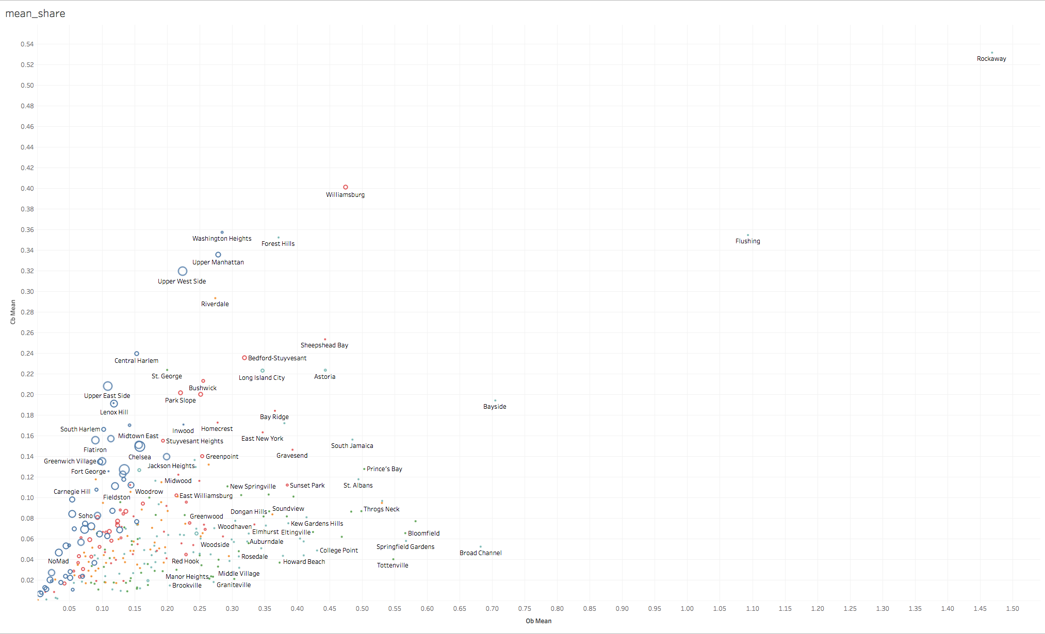

Slide 32
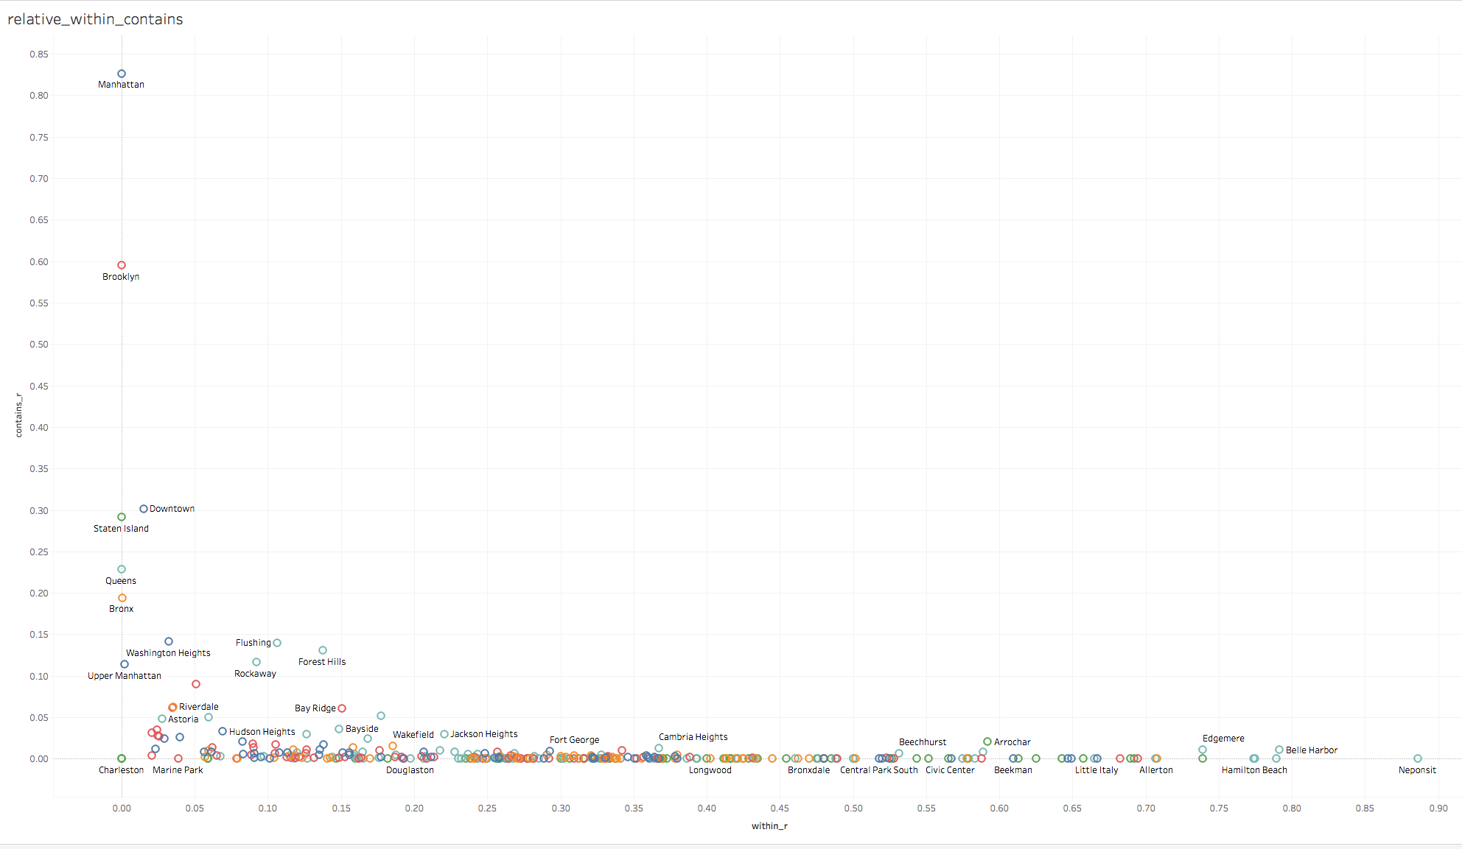

Slide 33
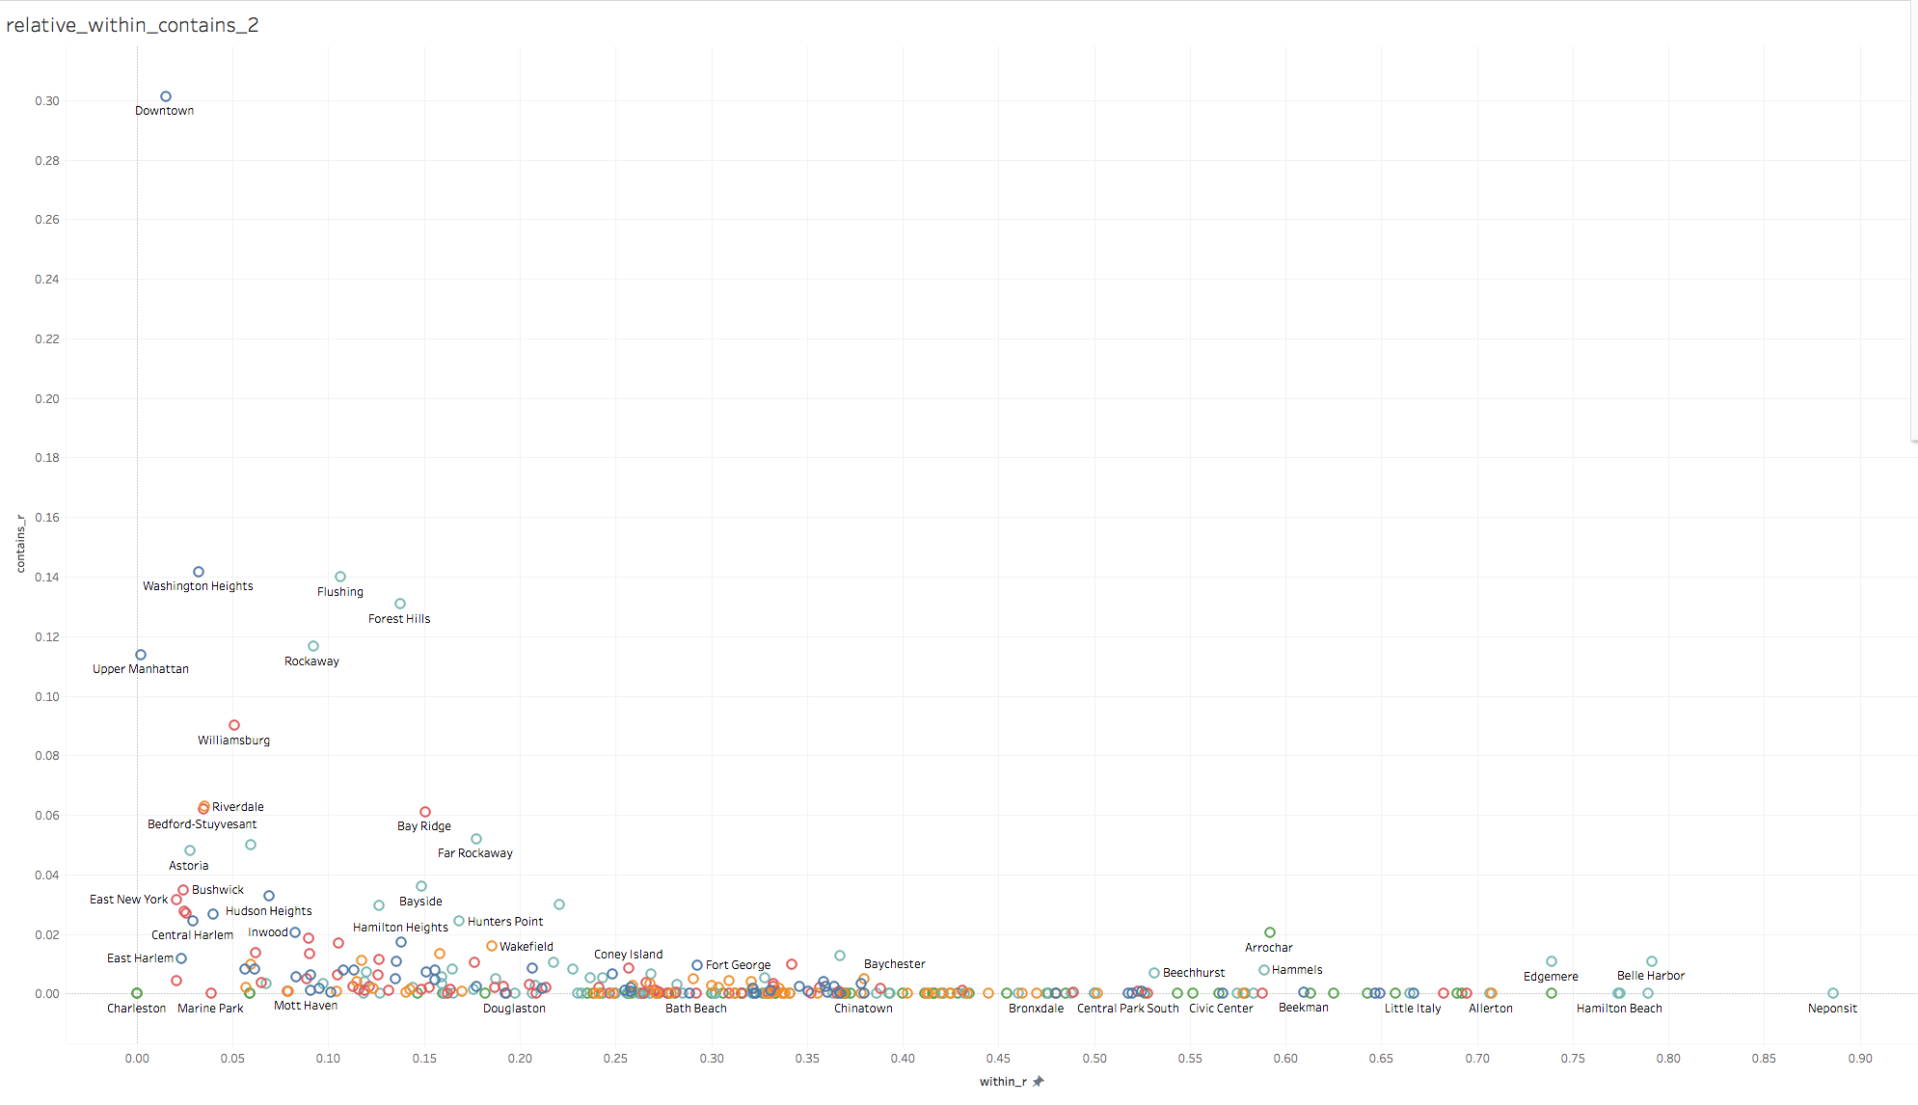

Slide 34
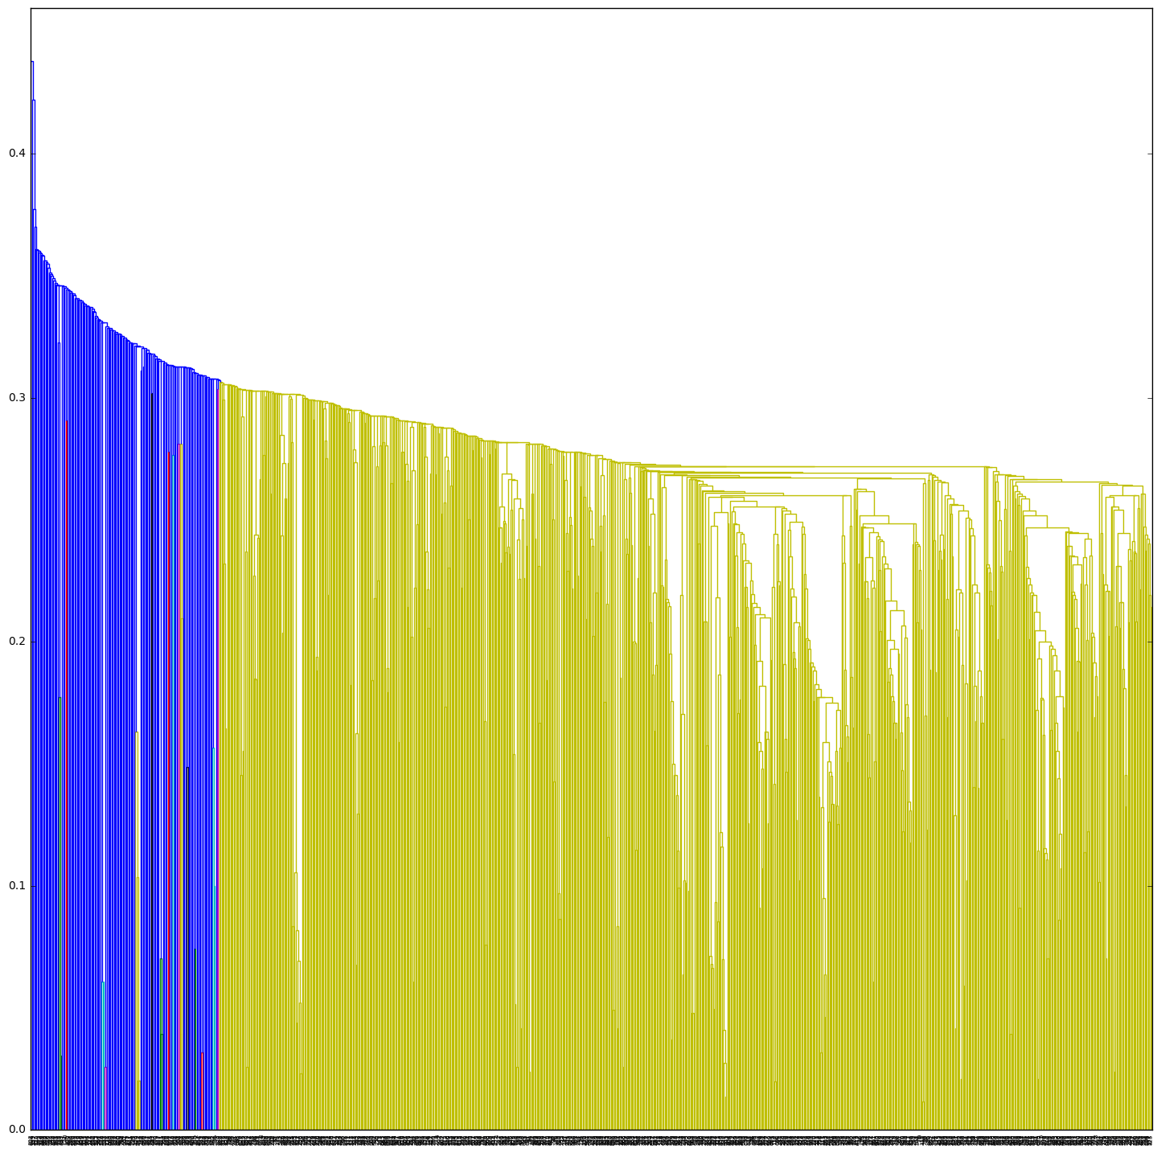

Slide 35
Next Steps
Official-to-Official Graph
Custom-to-Custom Graph
Time-to-time comparison
Text Mining
Sweet_Spots (density)

